Slide 1
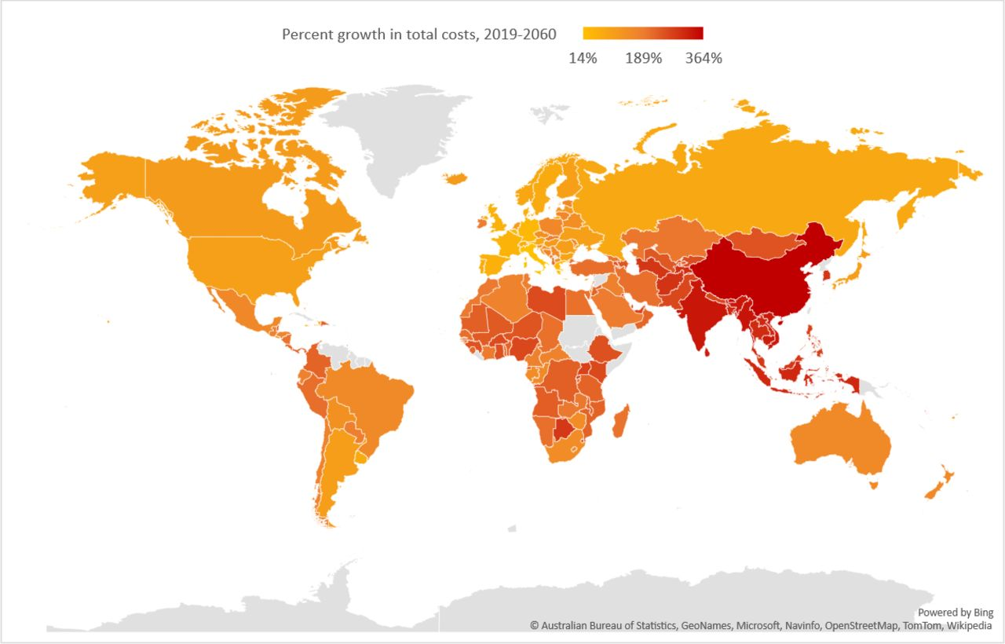

Percent growth in total economic impacts of OAO between 2019 and 2060. *Data displayed in map scaled using natural logarithm.
Adeyemi Okunogbe et al. BMJ Glob Health 2022;7:e009773
© Author(s) (or their employer(s)) 2022. Re-use permitted under CC BY-NC. No commercial re-use. See rights and permissions. Published by BMJ.
Notes:
Percent growth in total economic impacts of OAO between 2019 and 2060. *Data displayed in map scaled using natural logarithm. OAO, overweight and obesity.

